Slide 1
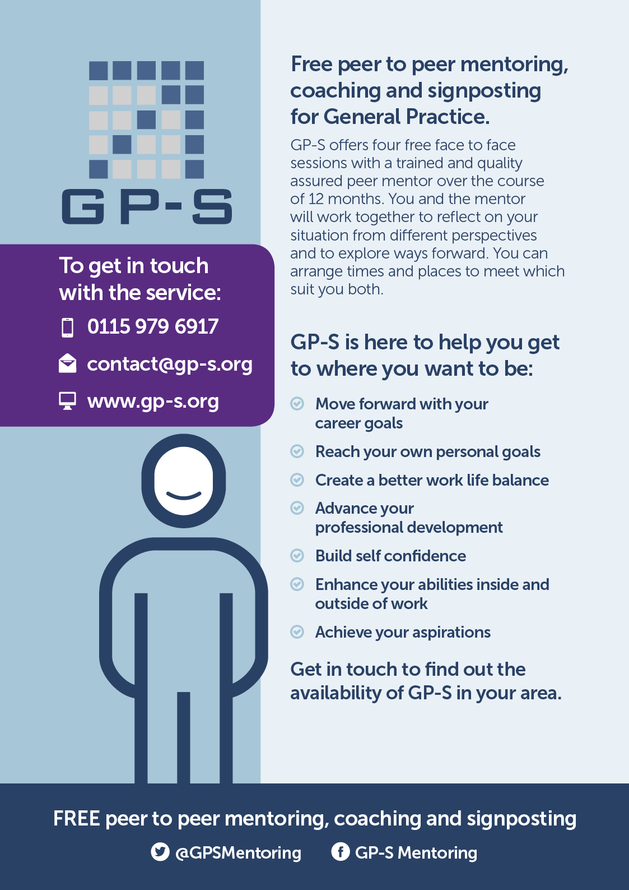
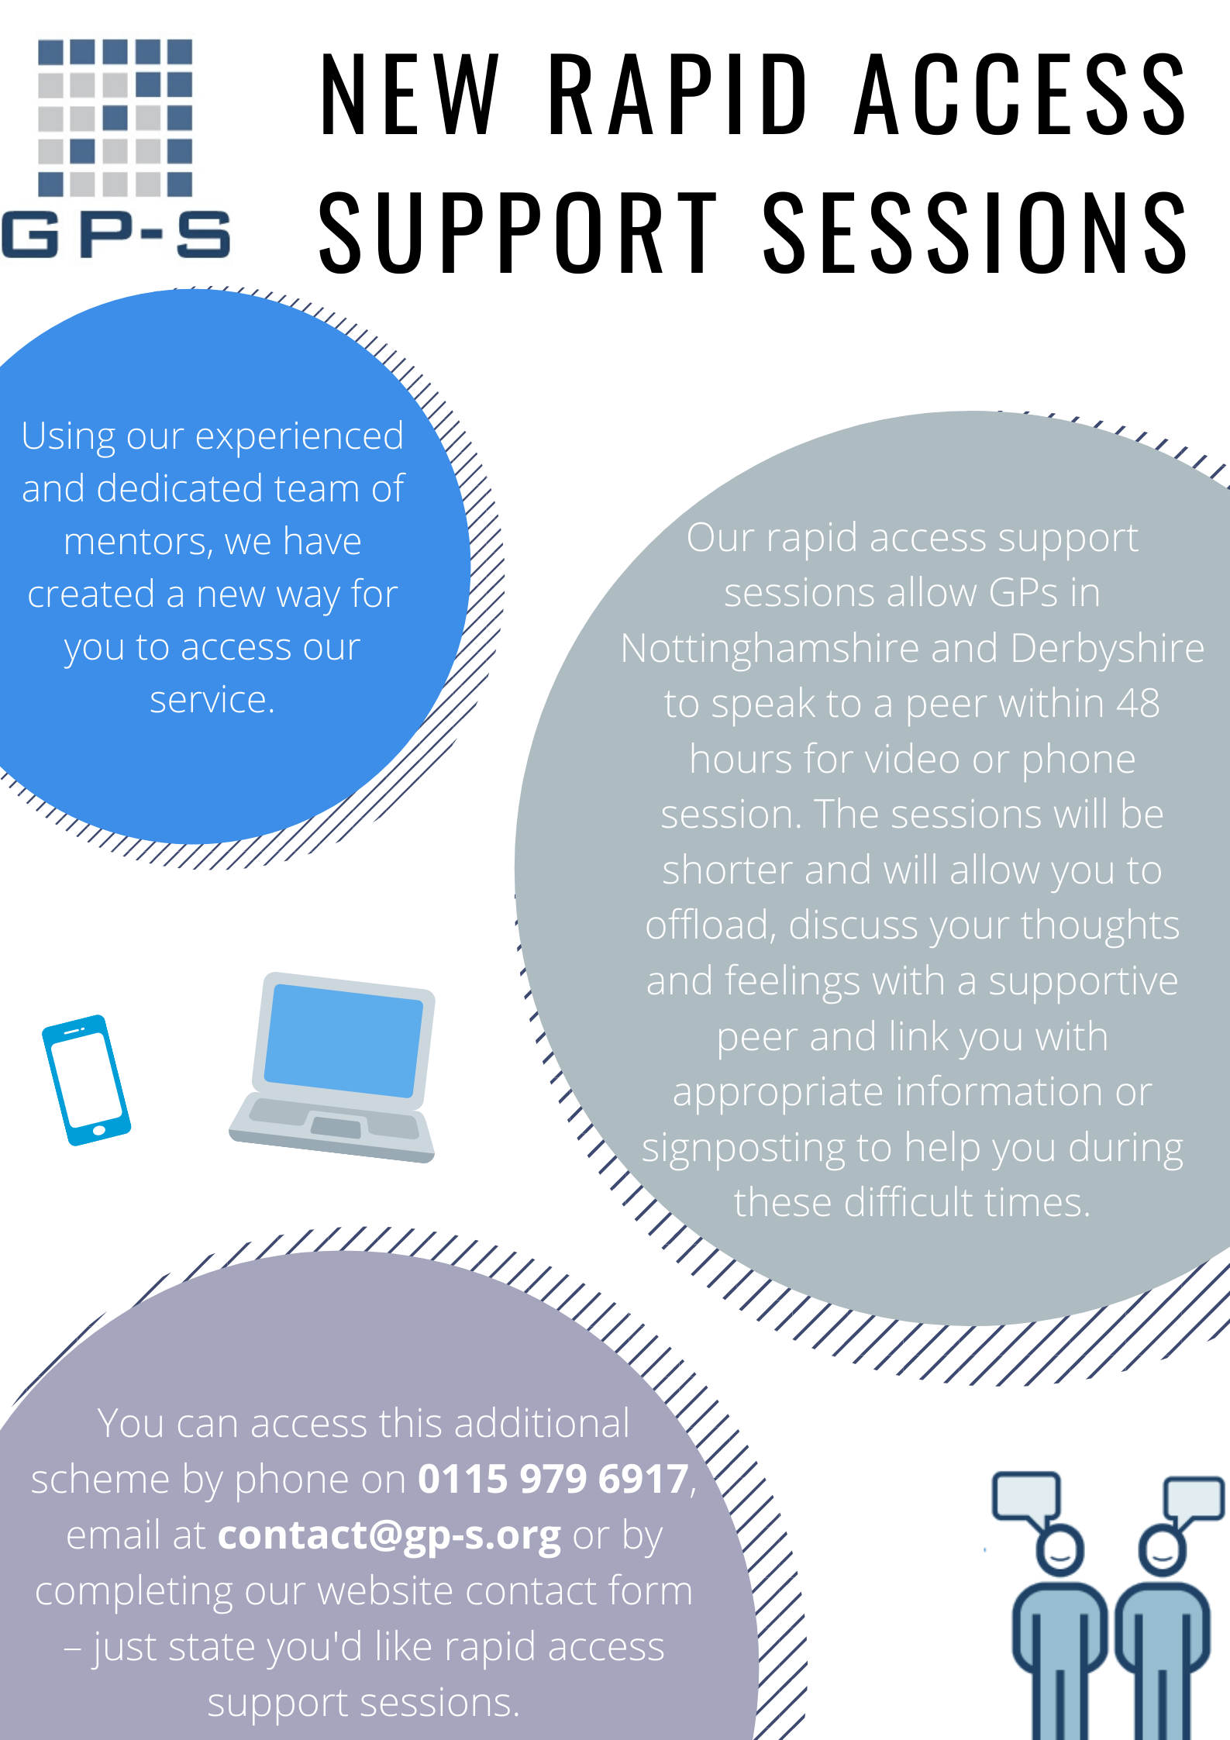
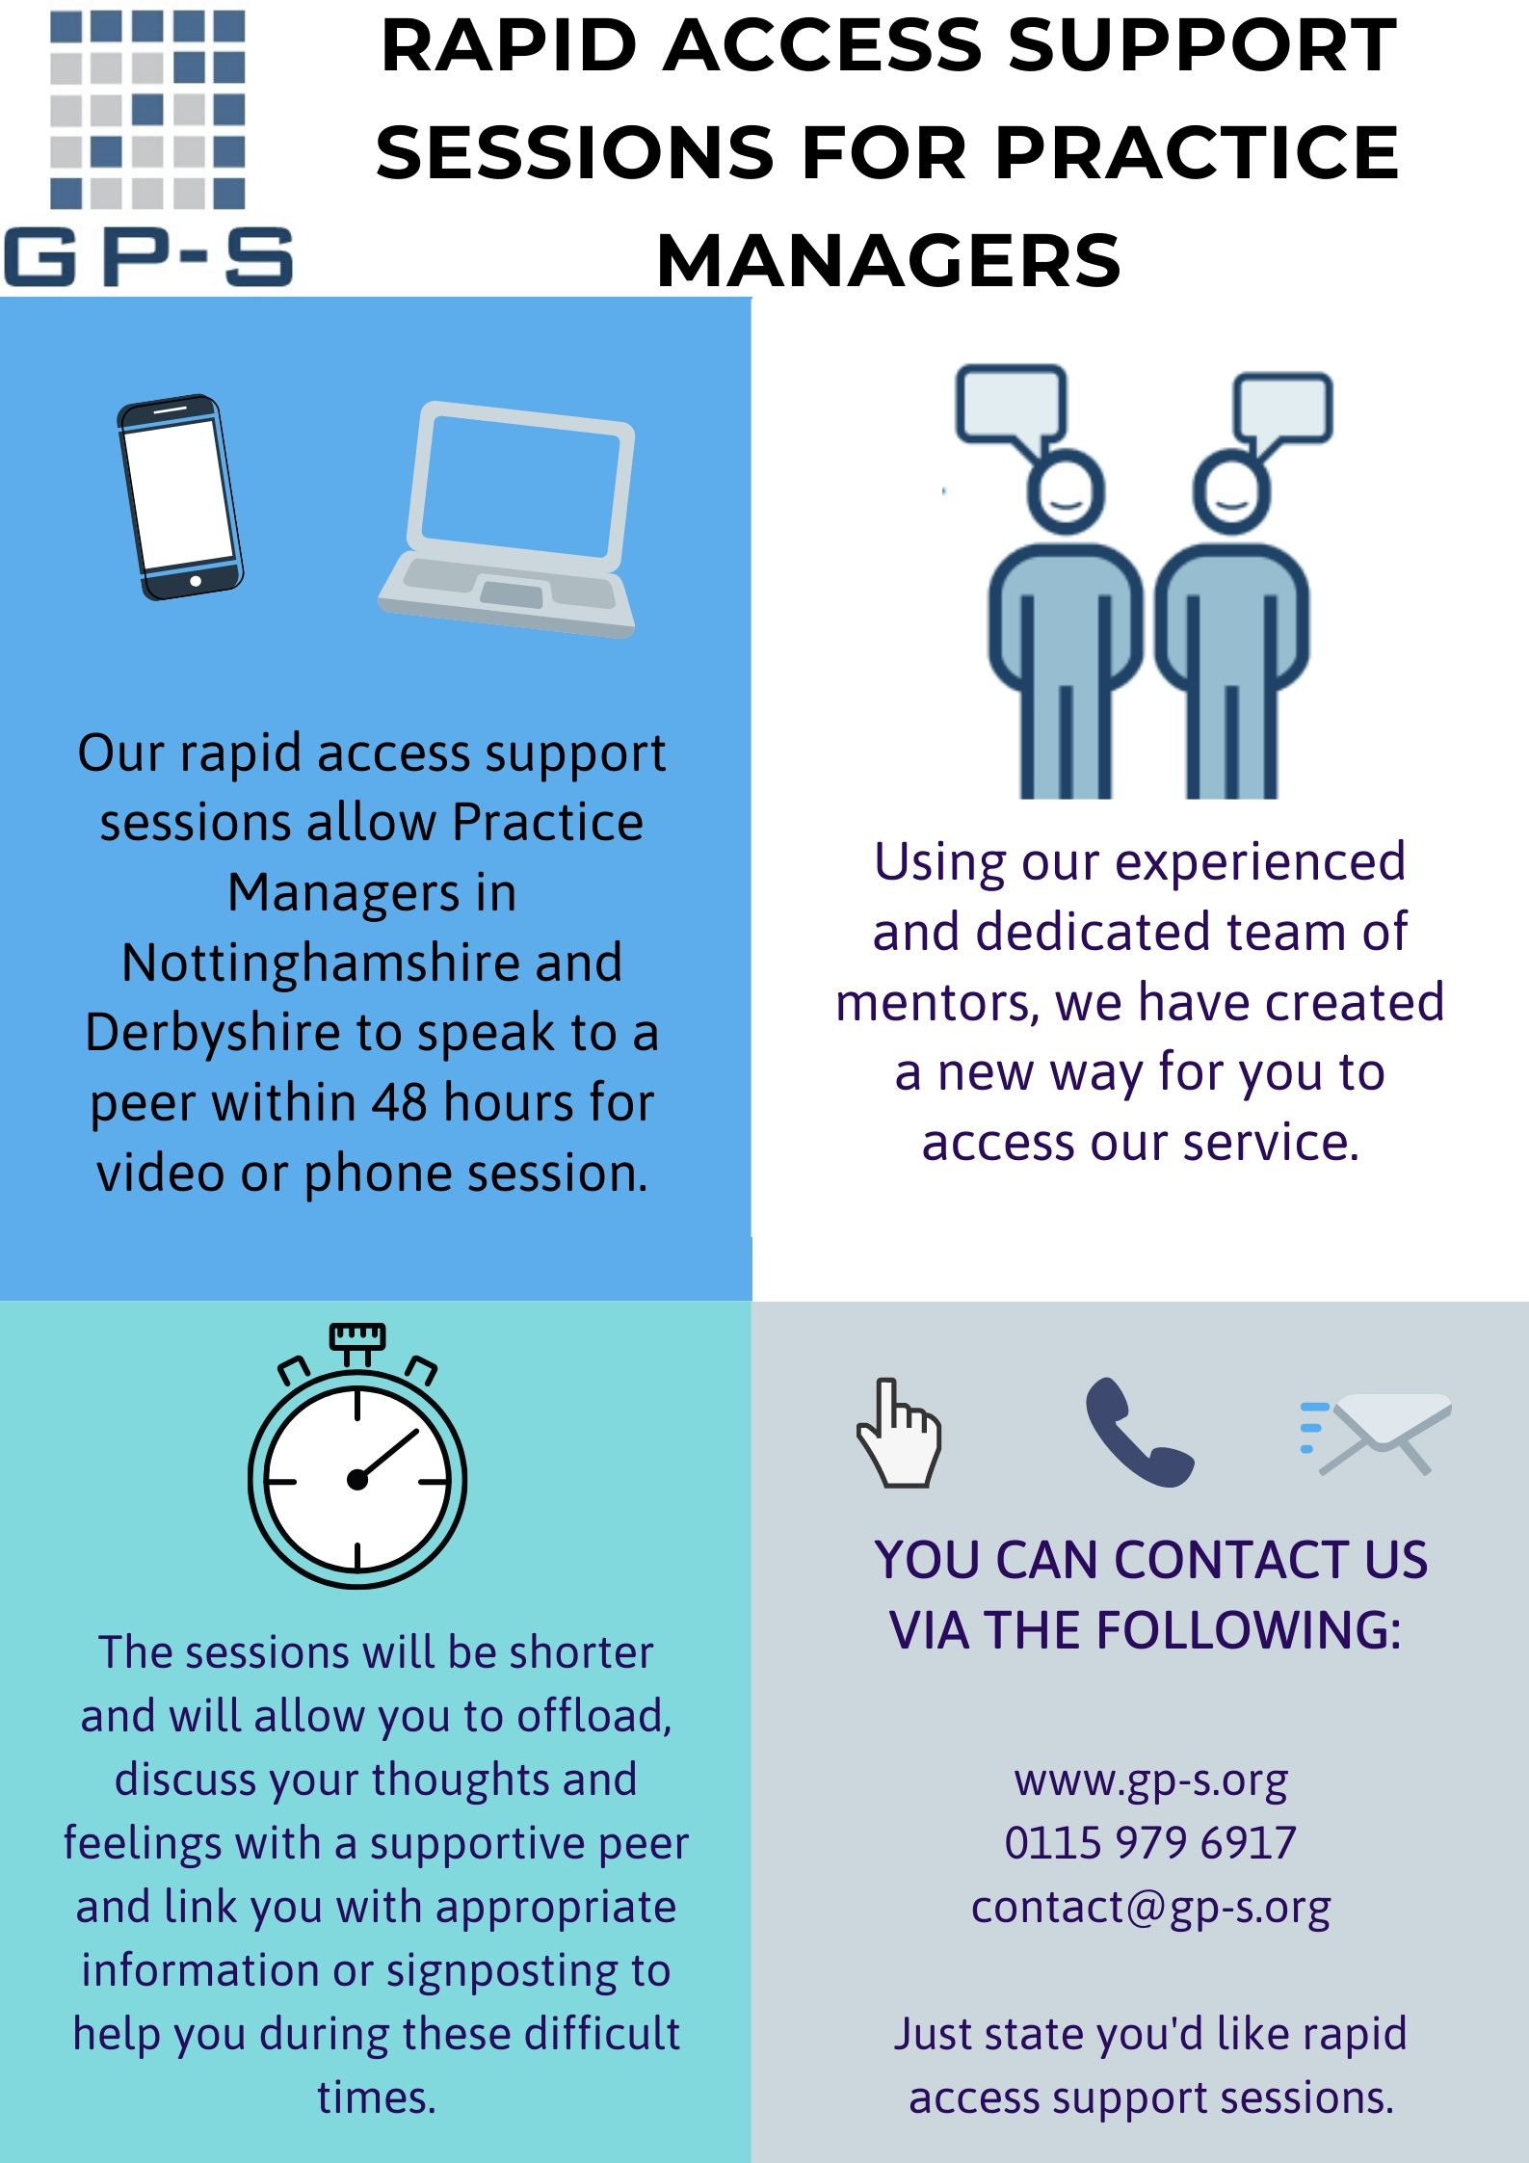
GP-S Support Schemes
Schemes available to all in Notts and Derby. Find out more: www.gp-s.org, 0115 979 6917 and contact@gp-s.org
Free confidential Peer Coaching and mentoring for GPs
Free confidential listening and signposting for GPs
Free weekly peer support group led by two trained expert mentors
Free confidential listening and signposting for Practice Managers

