Slide 1
Emergency Support Framework
Victoria Watkins, Deputy Chief Inspector for Primary Medical Services and Integrated Care
Dr Janet Hall National Professional Advisor Primary Medical Services
Notes:
1

Slide 2
What will we cover today?
Our role and purpose
Introduction
Our interim approach - overview
Context for primary care
Challenges for primary care
Interim approach steps - more detail
Stay up to date

Slide 3
Our role and purpose
The Care Quality Commission is the independent regulator of health and adult social care in England
We make sure health and social care services provide people with safe, effective, compassionate, high-quality care and we encourage care services to improve

Slide 4
Introduction
Although we have paused our routine inspections, our regulatory role and core purpose of keeping people safe has not changed – safety is still our priority.
We have developed an emergency support framework which we will follow during the pandemic.
We will use this emergency approach in all health and social care settings registered with CQC during the pandemic, and for a period afterwards.
We will adapt our approach and any regulatory actions, to the different needs of people who use services and providers in each sector – and update the guidance as the situation evolves.
Our emergency support framework is not an inspection, and we are not rating performance.
This is a flexible process which we’ll improve as we learn and through feedback from you and others
Notes:
The information that we gather through this route is a further source of intelligence that we are using to monitor risk, identify where providers may need extra support to respond to emerging issues, and ensure they are delivering safe care which protects people’s human rights.
It aids our understanding of the impact of coronavirus on staff and people using services, and where we may need to follow up directly with an inspection, or escalate concerns to regional, and national system partners where they are best placed to address.

Slide 5
Current context of primary care
Recognition of huge amount of work primary care providers have done to provide safe care and treatment to patients during these last few weeks and introduce innovative new ways of working
Reduced numbers of patients attending surgery
Rapidly adapted to new ways of working:
Clinical telephone triage before patient contact
Remote consulting: telephone, video, messaging and online consultations
Increased electronic prescribing and repeat dispensing
Increased electronic communication and sharing information eg fit notes
Live video consultations - Prior to Covid-19 only 5% practices, now 97% practices
Online consultations - <30% practices by end of March 20, now 75% practices with 20% in progress

Slide 6
Current challenges faced by primary care
Enormous challenges faced by primary care providers, staff and patients:
PPE shortages
Staffing issues eg absences, shielding, new roles and responsibilities
Difficulty accessing COVID-19 testing
Change in working environment eg hot hubs/rooms, home working, different locations, home visits
Constant changes and updates to guidance
New legislation eg death certification, cremation, re-use medicines,
Rapid response to notifications to take on additional work eg shielding, care homes
Advanced care planning and contacting high risk patients
Working additional hours eg Easter bank holiday
Work prioritisation
Lack of access to resources eg investigations, referrals, physios etc

Slide 7
5. If there are concerns, taking action to keep people safe
Our interim approach
1. Monitoring information
2. Prioritising contact
3. Open and honest conversations with providers
4. Sending a summary to providers
7. Sharing information we hold
6. Signposting to sources of support and guidance
7

Slide 8
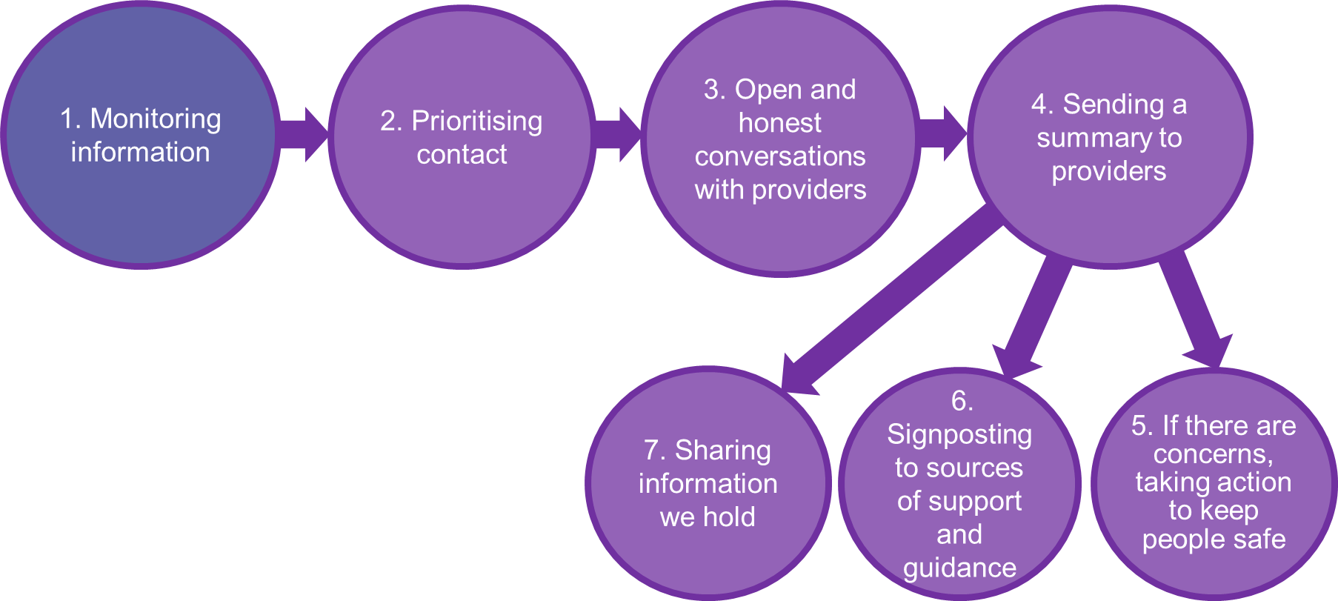
1. Monitoring information
Data from our usual sources:
QOF data
Data on immunisations and screening
Current enforcement activity
Previous ratings
Statutory notifications
Feedback from public and staff, and new sources.
Information gathered from recent Annual Regulatory Review calls
Information we receive from people who use services
The public
Other external data sources eg CCG, NHSE/I, Healthwatch, voluntary sector, LMCs

Slide 9
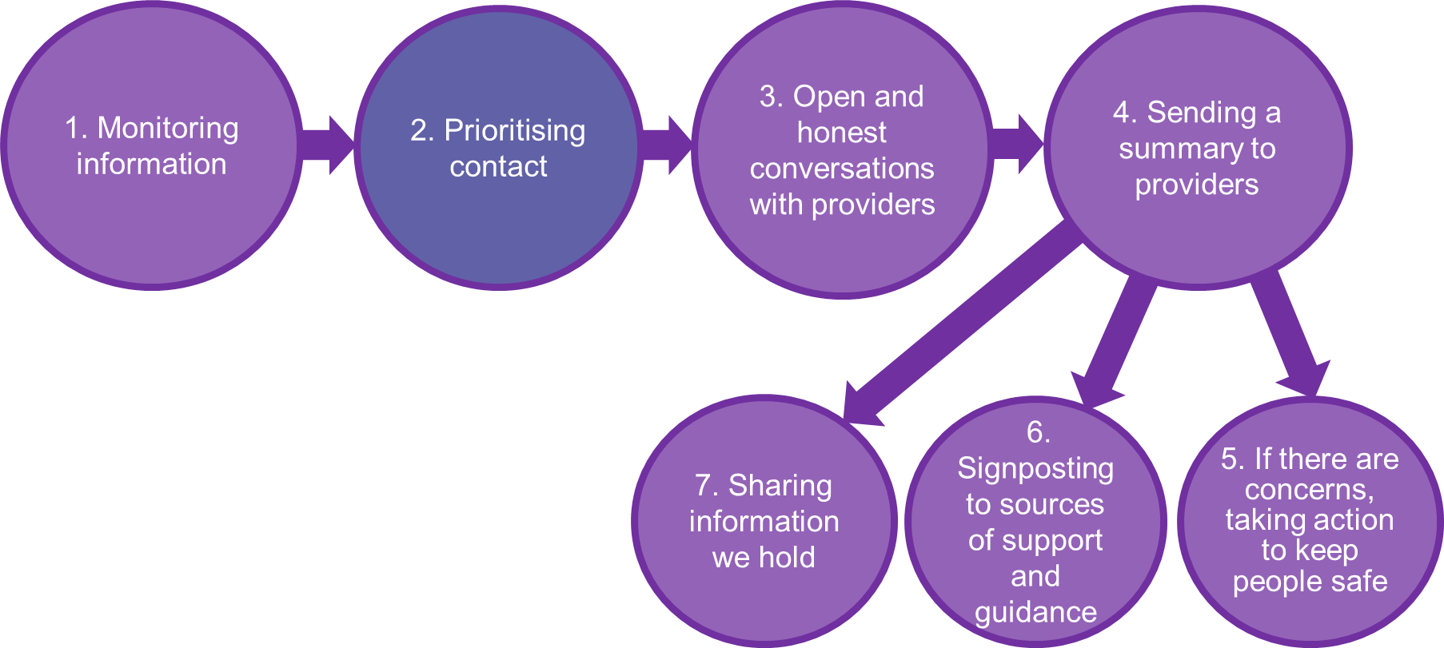
2. Prioritising contact
The information we receive, helps us prioritise the ESF calls
Inspectors will make contact to arrange a date and time convenient to you, to call, either by using Microsoft Teams or by telephone.
As we continue to monitor and engage, a service with a higher risk level will have more contact from its inspector, and this will continue to until the emergency period is over.
Providers will be signposted to useful guidance and sources of support
This approach means we’re able to target our support and action most effectively.
Providers involved in the ESF pilot commented on the benefits of the process

Slide 10
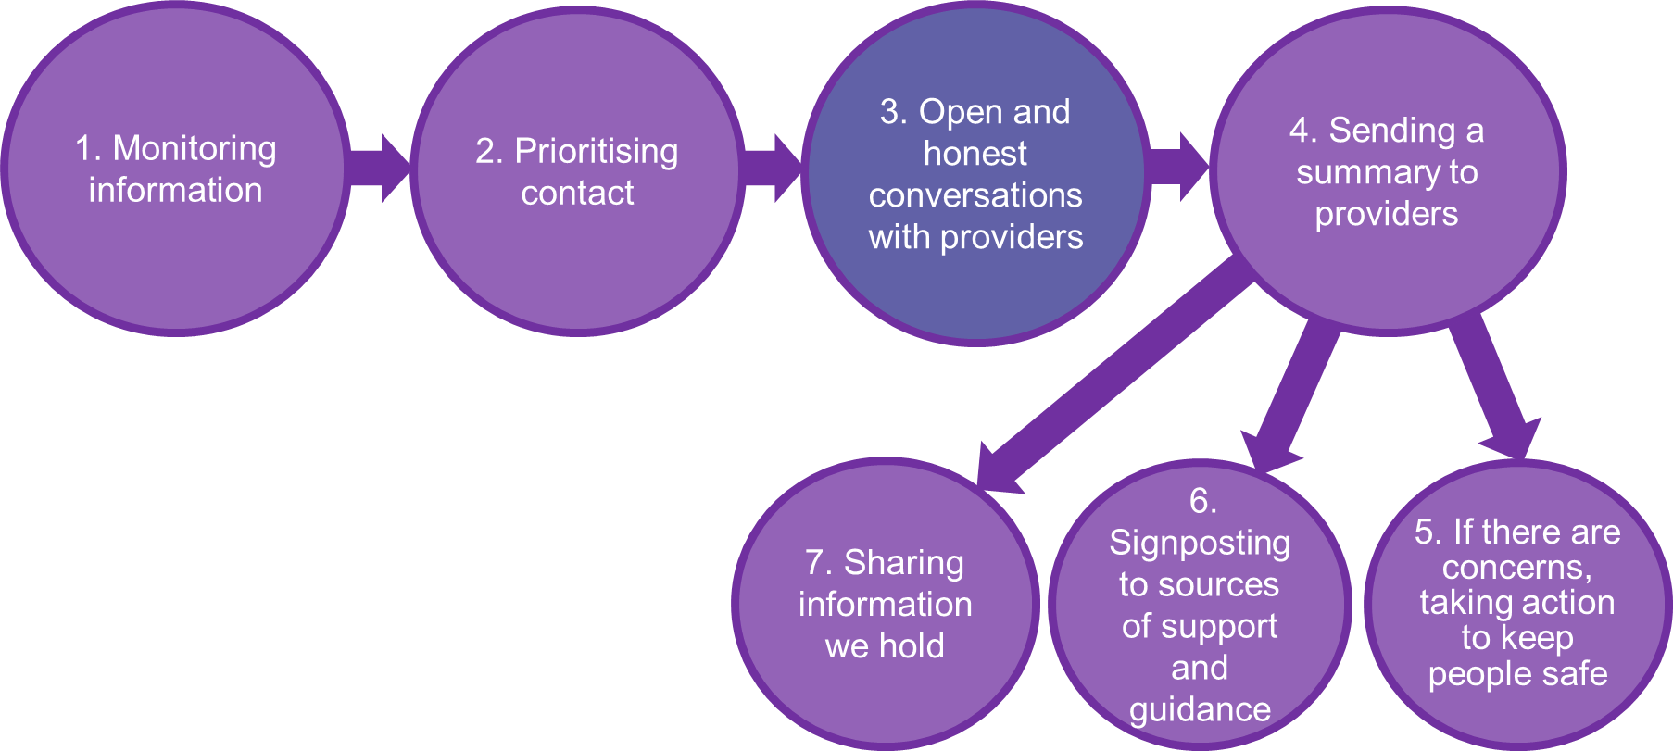
3. Having an open and honest conversation with providers
And gathering and recording information from the conversation
Focusing on four main areas:
Safe care and treatment
Staffing arrangements
Protection from abuse
Assurance processes, monitoring, and risk management
This is a two way conversation and we want to hear about your experiences during this time, including innovative ways of working and good practice that has been introduced

Slide 11
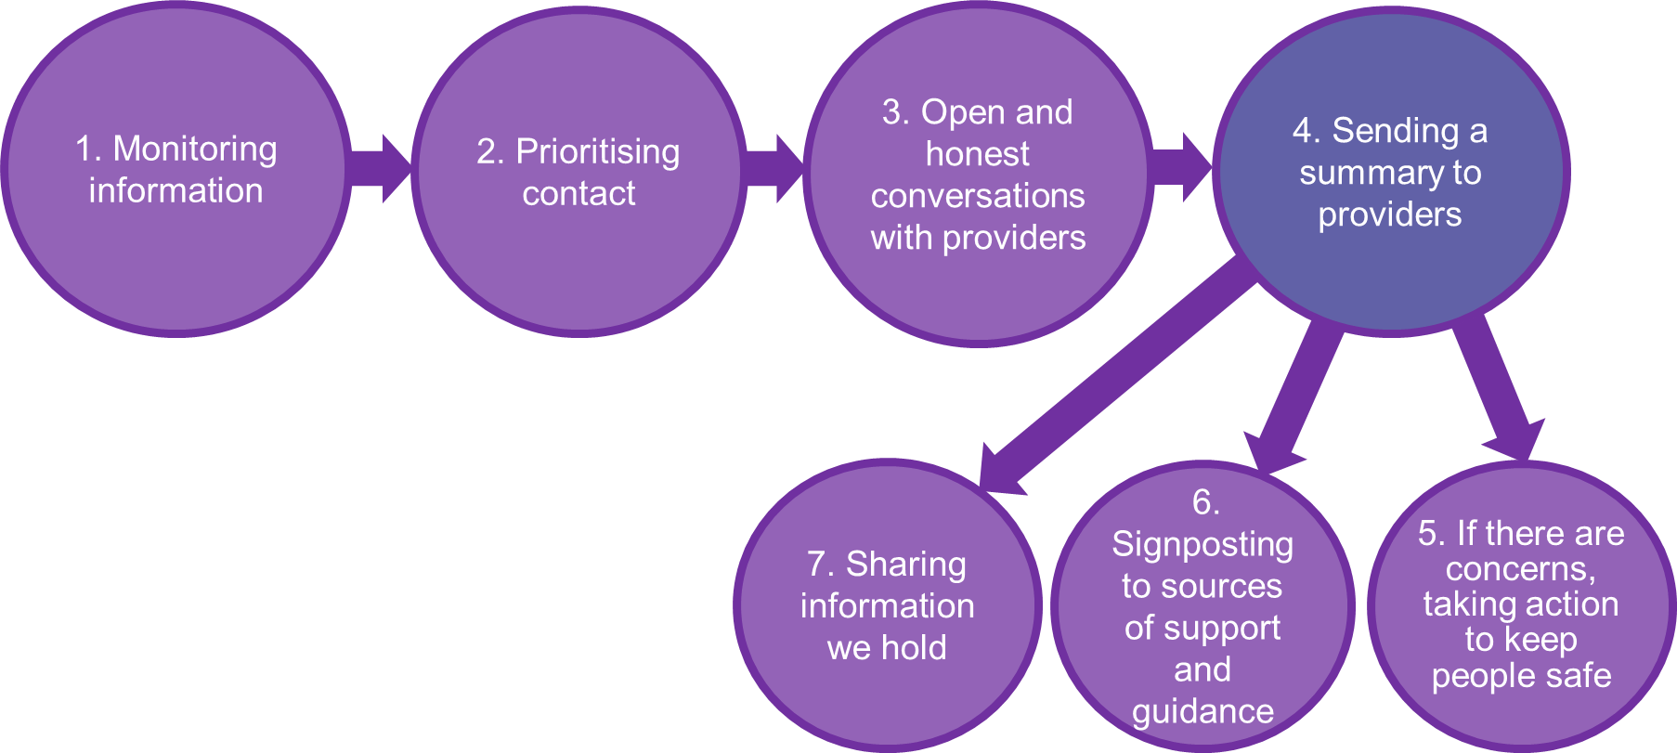
4. Sending a summary record to providers
The inspector will make notes during your call and will summarise
the conversation, which will be emailed to you in a PDF format.
The PDF will include:
standard wording that reflects your answers to our questions
a summary of specific internal and external risks and challenges including good practice or innovative ways of responding to challenges
any sources of support suggested
This is not an inspection and we will not publish this summary on our website.

Slide 12
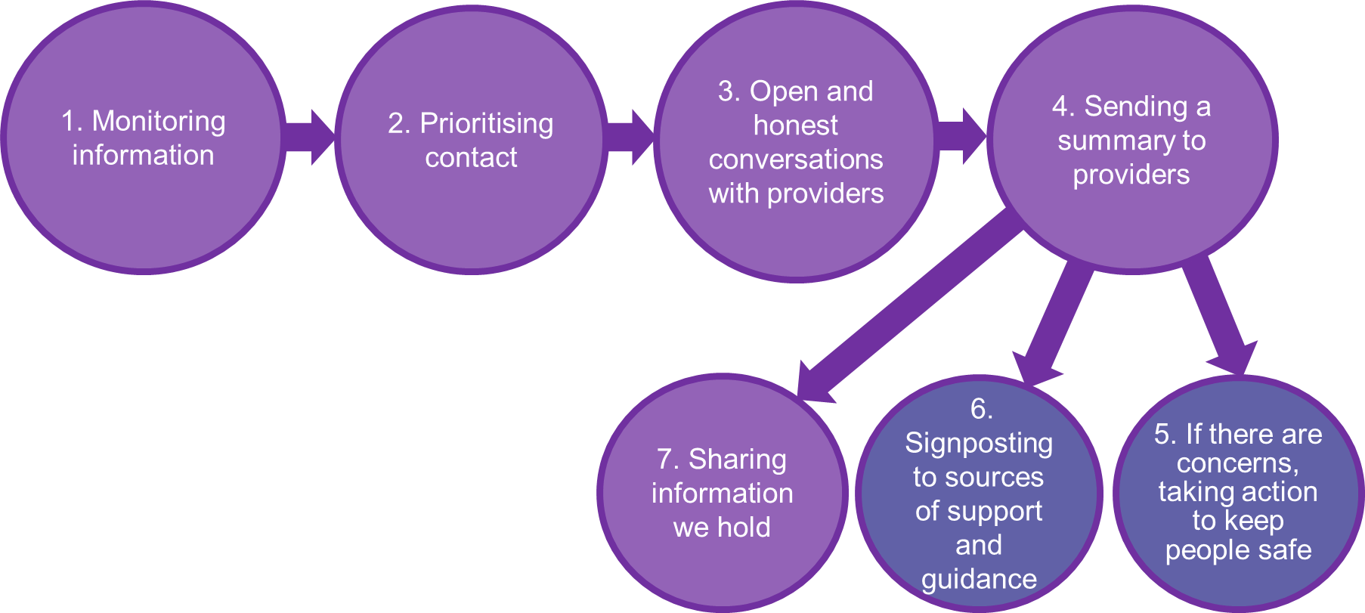
5. Taking action to keep people safe and protect their human rights
Information from calls forms a view as to whether a service is:
managing, or
needs support
If we have concerns, we either:
signpost to additional sources of support (6)
arrange a follow-up call
carefully assess regulatory action through use of inspection and enforcement processes

Slide 13
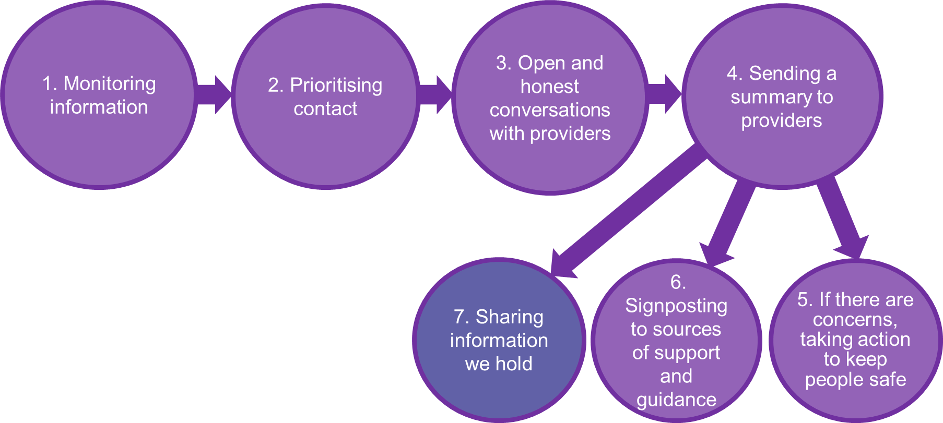
7. Sharing what we do
We will be open and transparent about our approach.
Use our data to produce and share regular information with local, regional and national system partners
We will share information on decisions as part of this process and information gathered through this emergency approach to help support the wider health and social care system to respond to issues and help providers to keep people safe.
The PDF summary will not be published on our website

Slide 14
Supporting you to support others
Notes:
Your local inspection team is there to support you.

Slide 15
Stay up to date
Provider Bulletin
Changed from monthly to weekly with a coronavirus (COVID-19) focus
Sign up here: https://www.cqc.org.uk/news/newsletters-alerts/email-newsletters-cqc
CQC Twitter account
For the most up to date, immediate information
Follow: @CQCProf
Dedicated coronavirus (COVID-19) webpage
Access the most up to date information, and guidance here
Visit: www.cqc.org.uk/coronavirus

Slide 16
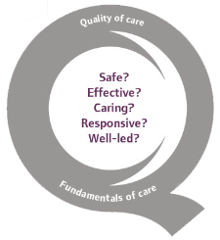
Thank you for joining us..
www.cqc.org.uk
enquiries@cqc.org.uk
@CareQualityComm
16
Notes:
16

