Slide 1
Derbyshire – Practices, Place, PCNs, CCG and GPTF Maps and Who’s Who. Information is correct at the time of publish 6.11. 2019

Slide 2
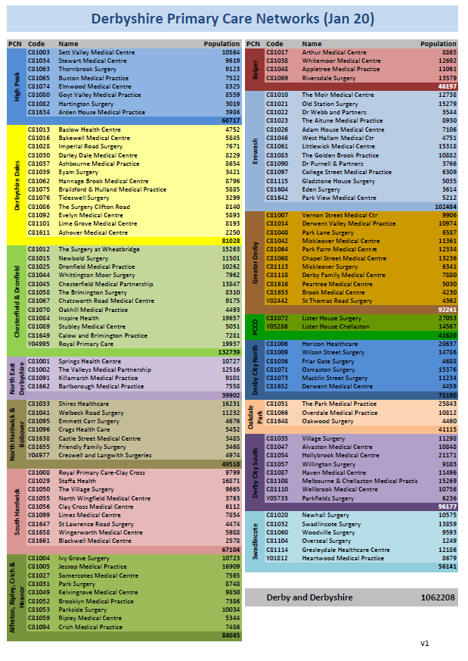

Slide 3
Derbyshire Primary Care Network (PCN) Clinical Directors
 | PCN | Population (June 19) | Clinical Director
 | High Peak | 60,487 | Dr Chris Harvey
 | Derbyshire Dales | 80,742 | Dr Victoria Hetherington, Dr Ben Milton
 | Chesterfield and Dronfield | 132,494 | Dr P J Flann
 | North East Derbyshire | 39,590 | Dr Steve Rossi
 | North Hardwick and Bolsover | 49,326 | Dr R Vasudevan, Dr M Srinivasan
 | South Hardwick | 66805 | Dr Sid Chawla
 | Alfreton, Ripley, Crich & Heanor | 83,593 | Dr Nicholas Hall, Dr Andrew Mott, Dr Justine Reid
 | Belper | 46,168 | Dr Heather Kinsella, Dr Andrew Maronge
 | Erewash | 102,298 | Dr Duncan Gooch, Dr Antony Shanks
 | Greater Derby | 91724 | Dr Gillian Davidson, Dr Vineeta Rajeev
 | Primary Care Community Option PCCO | 40,241 | Dr Mahya Johnson
 | Derby City North | 71,395 | Dr Richard Crowson, Dr Drew Smith (co- clinical lead)
 | Oakdale Park | 40,784 | Dr Helen Hill, Dr Simon Gregory
 | Derby City South | 95,204 | Dr Riten Ruparelia
 | Swadlincote | 55,904 | Dr Andrew Marshall

Slide 4
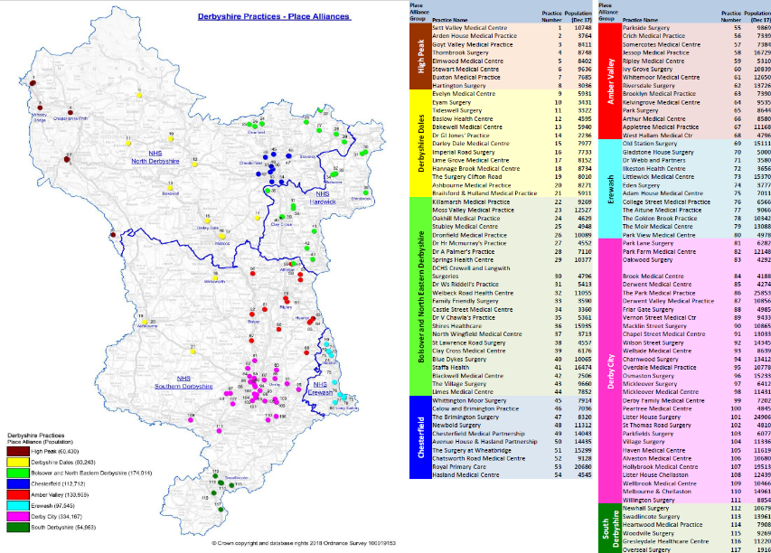

Slide 5
Derbyshire Place Leads
 | Place | Population | Place Leads
 | High Peak | 60,430 | Debbie Austin
 | Derbyshire Dales | 80,243 | Pauline Love
 | Bolsover and NE Derbys. | 174,014 | Richard Butler
 | Chesterfield | 112,712 | Anne-Marie Spooner
 | Amber Valley | 133,959 | Anne Tompkinson
 | Erewash | 97,545 | Markus Henn
 | Derby City | 334,167 | Raj Komal
 | South Derbys. | 54,953 | Saritha Somarajan

Slide 6
Place Alliances
Place Alliance Groups | Organisational Clinical & Professional Links
 | General Practice / CCG | UHDB | CRH | DCHS | DHcFT | DHU | DCC/ Derby City
North East Derbyshire & Bolsover | Dr Richard Butler |  |  | Janine Foxhall | Andrea Heath | Kirsty Osborn | Di Bassett (DCC) Phil Wall (DCC) James Green (PH)
Chesterfield | Dr Anne–Marie Spooner |  |  | Janine Foxhall |  | Kirsty Osborn
Derbyshire Dales | Dr Pauline Love |  |  | Jonathan Sanderson | Jo Hanby | TBC | Craig Jaques-Newton (DCC) Sue Whetton (DCC) Lucy Gavens (PH)
High Peak | Dr Debbie Austin |  |  | Jonathan Sanderson | Anna Bennett | TBC | Cheryl Pike (DCC) Di Higton (DCC) Melusi Ndebele (PH)
Amber Valley | Dr Anne Tompkinson |  |  | Jo Sills | Dave Nunn | Ian Truby-Ware | Yvonne Hobday (DCC) Jude Boyle (DCC) Helen Johnston (PH)
South Derbyshire and Swadlincote | Dr Saritha Somarajan |  |  | Dom Fackler, Jane Warder |  | Ian Truby-Ware | Rob Lowe (DCC) Steve Ball (DCC) Justin Halford (DCC) Vicky Smyth (PH)
Erewash | Dr Markus Henn |  |  | Jo Sills | Paula Hathaway | Paul Tilson | Dom Sullivan (DCC) Lisa Redington (DCC) Olu Ogunbuyide (DCC) James Green (PH)
Derby City | TBC - Discussions ongoing |  |  | Jackie Rawlings | Tess Martin | TBC | Perveez Sadiq (DC) Louisa Hadley (DC) Robyn Dewis (PH)

Slide 7
Derby & Derbyshire CCG Governing Body GPs
CCG Chief Exec
Dr Chris Clayton
CCG Clinical Chair
Dr Avi Bhatia
CCG Medical Director
Dr Steve Lloyd
CCG Deputy Medical Directors
Dr Kath Bagshaw and Dr Sam Taylor
CCG Governing Body GPs
Dr Avi Bhatia
Dr Penny Blackwell
Dr Steve Lloyd
Dr Buk Dhadda
Dr Greg Strachan
Dr Emma Pizzey
Dr Merryl Watkins
Dr Ruth Cooper

Slide 8
Derby & Derbyshire CCG Clinical Leads
Clinical leads
Diabetes/Endocrinology: Dr Kriss Owen
Cancer: Dr Louise Merriman
Circulatory Disease: Dr Tarun Narula
Children's Health and Mat: EoI TBA
Women’s and Men’s Health: Dr Riten Ruparelia
Urgent Care: Dr Paul Wood
End of Life: Dr Pauline Love
Respiratory: Dr Seema Kuman
MSK: Dr Vikas Gupta
Gastroenterology: Dr Caroline Garside
Mental Health and Learning Disabilities: Dr Sohrab Panday
Older People’s Health: Dr Justin Walker
Neurology: Dr Mark Wood
Prescribing: Dr Carolyn Emslie, Dr Buk Dhadda, Dr Helen Hill, Dr Ruth Gooch

Slide 9
CCG Clinical Leads
CCG Workstreams | Clinical Lead
Circulatory Disease including stroke disease | Dr Tarun Narula
Diabetes/ endocrinology | Dr Kriss Owen
Women and Men’s health (inc Urology, CKD, Obs/Gynae and Sexual health) | Dr Riten Ruparelia
Respiratory | Dr Seema Kumari
Gastroenterology inc Alcohol and Substance Misuse | Dr Caroline Garside
Neurology, Ophthalmology and Dermatology | TBC
Prescribing | Dr Carolyn Emslie Dr Buk Dhadda Dr Helen Hill Dr Ruth Gooch
Orthopaedics, rheumatology, pain management | Dr Vikas Gupta
Older peoples health and frailty | Dr Justin Walker

Slide 10
Clinical & Professional Links
 | Organisational Clinical & Professional Links
National Strategy Boards | General Practice / CCG | UHDB | CRH | DCHS | DHcFT | DHU | DCC | Derby City
Children’s and Young Persons | Dr Sophie Taylor | Cathy Winfield | Adam Barrow |  |  | N/A
Cancer | Dr Louise Merriman | Viren Asher | Hal Spencer | Bola Owolabi | N/A | N/A
Maternity | Dr Sophie Taylor (also link to MH) | Cathy Winfield | Linda Gustard |  | N/A | N/A

Slide 11
Clinical and Professional Links
Delivery Boards | Clinical & Professional Links
 | General Practice/CCG | UHDB | CRH | DCHS | DHcFT | DHU | DCC | Derby City
A) Planned Care Delivery Board | Dr Ruth Cooper | Mr Arthur Stephen |  |  | N/A | N/A | N/A | N/A
MSK Programme Board | Dr Vikas Gupta | Mr Simon Pickering |  |  | N/A | N/A | N/A | N/A
Outpatients Programme Board |  | Dr Arne Rose |  |  | N/A | N/A | N/A | N/A
Theatres Programme Board |  |  |  |  | N/A | N/A | N/A | N/A
Ophthalmology Board | Dr Raj Komal | Mr Roger Holden | Sanjay Choudhary |  | N/A | N/A | N/A | N/A
B) Place Delivery Board Supported by 8 Alliance Groups (see slide 3) | Dr Penny Blackwell |  |  | Dr Ben Pearson Bola Owolabi (frailty) |  |  |  | Perveez Sadiq
C) Mental Health and Learning Disabilities Delivery Board/s | MH/ LD/Autism: Dr Sohrab Panday Dementia: Dr Justin Walker | Dr Magnus Harrison |  |  |  | Tracey Sellers |  | Phil Taylor
D) Urgent Care | Dr Paul Wood | Can confirm from capacity work | Mansur Reza/ Chris Whale | Dr Ian Lawrence
E) End of Life | Dr Pauline Love |  | Lynne Andrews

Slide 12
GP Alliance GP Alliance Place Board JUCD PCLG Training Hubs
GP Alliance Lead
Dr Duncan Gooch
Place Board Chair
Dr Penny Blackwell
JUCD Chair
Mr John MacDonald
Primary Care Leadership Group
Dr Steve Lloyd
GP Training Hub Leads
Dr Chris Hewitt HEE Associate Postgrad Dean
Dr Stuart Holloway HEE Associate Postgrad Dean
Dr Ilona Bendefy and Dr Andy Fyall Educational leads

Slide 13
The Primary Care Team NHS Derby City and Derbyshire CCG What we do: commission General Practice and Optometry in Derbyshire and support General Practice development. The team sits within the CCG’s Medical Directorate (led by Dr Steve Lloyd). Clive Newman (clive.newman3@nhs.net) is Director of GP Development.
Team | Areas covered | Lead
Quality | Patient safety Clinical Effectiveness Patient Experience Nurse development (including GPN 10 point plan) | Marie Scouse Marie.scouse@nhs.net Tel: 01246 514060 Mob: 07826890363
GP commissioning | Commission national contract: link for all contract queries CCG commissioned enhanced services New GP Contract and PCN contracts | Hannah Belcher Hannah.belcher@nhs.net Tel: 01246 514205 Mob: 07825 112874
Transformation | GP Forward View (including extended access and workforce) Digital (with Paul Hetherington) GP strategy (incl. Premises strategy) Supporting PCN development & new contract / new models of care | Helen Dean Helen.dean14@nhs.net Tel: 01332 868666 Emma Prokopiuk emma.prokopiuk@nhs.net Mob: 07825 112874

Slide 14
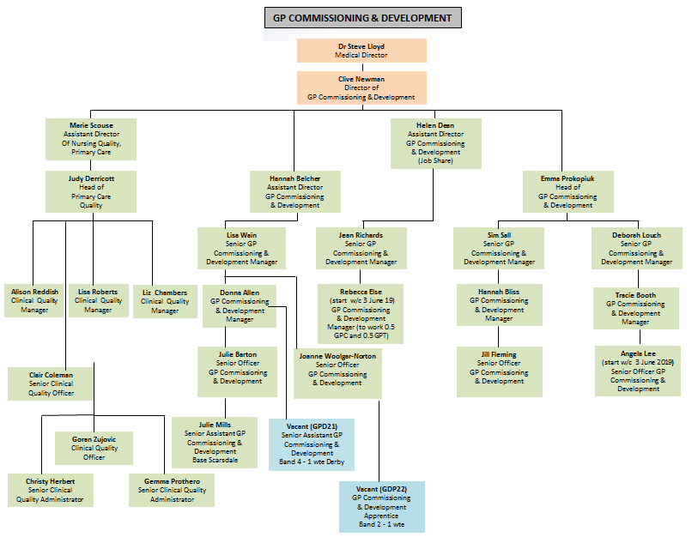
The Primary Care Team NHS Derby City and Derbyshire CCG Who we are: the team is split into three sub teams: quality, commissioning and transformation. We are based in Chesterfield (Scarsdale) and Derby (Cardinal Square)
Insert organisational chart – amended to show HB appointment alongside HD

Slide 15
Getting in touch
Name | Role | Email | Phone
Dr. Steve Lloyd | Medical Director | stevenlloyd@nhs.net
Dr. Kath Bagshaw | Deputy Medical Director | Via. ddccg.derbyshiregppractices@nhs.net
Dr. Sam Taylor | Deputy Medical Director | Via. ddccg.derbyshiregppractices@nhs.net
Clive Newman | Director of GP Development | clive.newman3@nhs.net |  | 07920 283518
Marie Scouse | Assistant Director of Nursing Quality, Primary Care | Marie.scouse@nhs.net |  | 07826890363
Hannah Belcher | Assistant Director, GP Commissioning & Development | Hannah.belcher@nhs.net |  | 07825 112874
Helen Dean | Assistant Director, GP Commissioning & Development (Wed – Friday) | Helen.dean14@nhs.net |  | 01332 868666
Emma Prokopiuk | Head of GP Commissioning & Development (Mon – Thurs) | emma.prokopiuk@nhs.net |  | 07825 112874

Slide 16
Derby & Derbyshire LMC General Practice Task Force - GPTF
DDLMC Chief Executive
Dr Kath Markus
DDLMC.Office@nhs.net
DDLMC Chief Operating Officer
David Gibbs
DDLMC.Office@nhs.net
GPTF Clinical Lead
Dr Susie Bayley
DDLMC.GPTF@nhs.net
GPTF Head of Business Support
Claire Leggett
DDLMC.GPTF@nhs.net
Please send all additions and amendments to the enclosed information to DDLMC.Office@nhs.net

